Slide 1
Introduction to Segment Routing
Standard: RFC 8402
LEONIR HOXHA
Senior Network Consultant
CISCO
CCIE #49534

Slide 2
Agenda
Todays Challenges
Segment Routing overview & building blocks
Prefix SID
Adjacency SID
Topology Independent LFA (aka: Ti-LFA)
Segment Routing Traffic Engineering
PCE Controller
Use Cases
FlexAlgo, SDWAN over SR, Disjointness with SR-PCE, and Inter-AS with BGP Peering SID

Slide 3
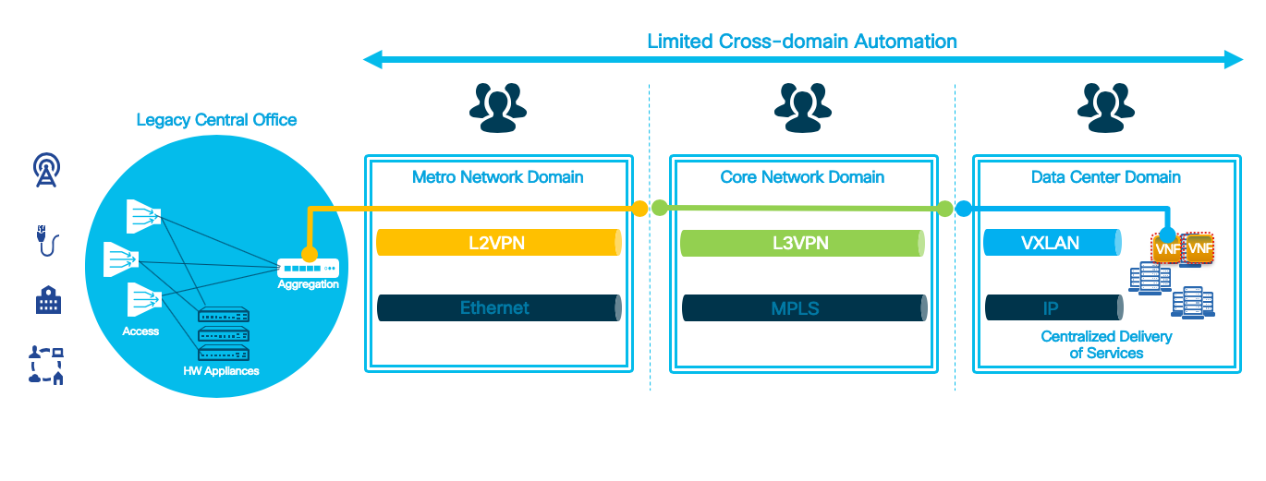
Service Creation Challenges
Complex End-to-End service provisioning:
Service stitching
Manual Operations
Heterogeneous Underlay and Overlay networks

Slide 4
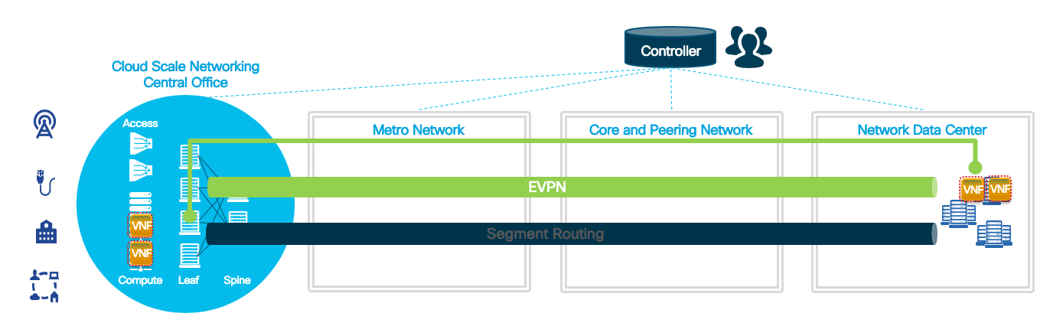
Unified “Fabric” for Service Creation
Unified underlay and overlay networks with Segment Routing and EVPN
E2E cross-domain automation with model-driven programmability and streaming telemetry

Slide 5
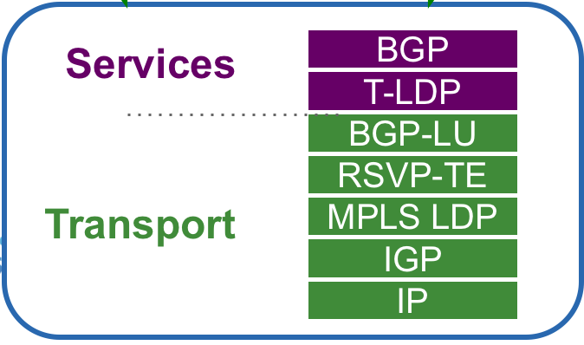
Network Transport Evolution
Unified MPLS
SR
Enabled Transport
BGP-EVPN
IGP/SR
IP

Slide 6
Segment Routing overview and Building Blocks

Slide 7
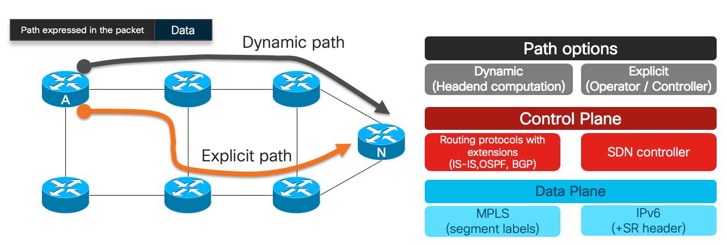
Segment Routing
The source chooses a path and encodes it in the packet header as an ordered list of segments
Segment: is an identifier for any type of instruction
I.e. ”Go to Node N using the shortest path”

Slide 8
Segment Routing – Forwarding & Control Plane
MPLS: an ordered list of segments is represented as a stack of labels
IPv6: an ordered list of segments is encoded in a routing extension header
IGP distributes following Segment ID’s (SID)
Prefix Segment (Node SID or Anycast SID)
Adjacency Segment
16002
24001
B
16001
24001
A
24002
16003
24001
C

Slide 9
Segment Routing – Prefix Segment ID
16005
Shortest-path to the IGP prefix
Equal Cost MultiPath (ECMP)-aware
Global Segment (global significance)
Label: 16000 – 24000 (default SRGB)
Statically assigned
Distributed by ISIS/OSPF
1
2
1.1.1.5/32
16005
16005
16005
5
16005
16005
3
4
16004
16005
1
2
All nodes use default SRGB 16,000 – 23,999
16004
16004
16004
5
16004
16004
3
4
1.1.1.4/32
16004

Slide 10
Segment Routing – Adjacency Segment ID
Forward to IGP adjacent Node
Local Segment (local significance)
Advertised as label value
Dynamically assigned
Distributed by ISIS/OSPF
1
2
5
Adj to 2
24042
3
4
Adj to 5
24045
24043
Adj to 3

Slide 11
Segment Routing – Combined SIDs
Steer traffic on any path through the network
Path is specified by a stack of labels
No path is signaled
No per-flow state is created
Single protocol: IS-IS or OSPF
16004
24045
Packet to 5
1
2
5
24045
Packet to 5
3
4
16004
24045

Slide 12
Topology Independent LFA (Ti-LFA)

Slide 13
Topology Independent LFA (Ti-LFA)
100%-coverage 50-msec link and node protection
Simple to operate and understand
automatically computed by the IGP
Prevents transient congestion and suboptimal routing
leverages the post-convergence path, planned to carry the traffic

Slide 14
Topology Independent LFA (Ti-LFA)
TI-LFA for link R1R2 on R1
Calculate P and Q spaces
Calculate post-convergence SPT
Find Q and adjacent P node on post-convergence SPT
R1 will push the prefix-SID of R4 and the adj-SID of R4-R3 link on the backup path
A
Z
Packet to Z
Packet to Z
R1
R2
prefix-SID(R4)
adj-SID(R4-R3)
R5
prefix-SID(Z)
prefix-SID(Z)
Packet to Z
Packet to Z
R4
R3
R4
R3
1000
P-space
Q-space
adj-SID(R4-R3)
Default metric: 10
prefix-SID(Z)
Packet to Z

Slide 15
Segment Routing Traffic Engineering

Slide 16

Traditional MPLS/RSVP-TE
Link information Distribution
ISIS-TE
OSPF-TE
Path Calculation
Path Setup
Forwarding Traffic down path
Auto-route
Static route
PBR
Forwarding Adjacency
Pseudowire Tunnel select
Head end
IP/MPLS
Mid-point
Tail end
TE LSP

Slide 17
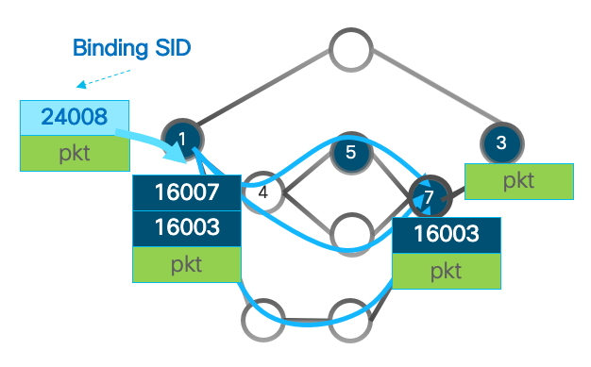
Segment Routing Traffic Engineering
Binding Segment is a fundamental building block of SRTE
The Binding Segment is a local segment
Has local significance
A Binding-Segment ID identifies a SRTE Policy
Each SRTE Policy has one Binding-SID associated
Packet received with Binding-SID as top label is steered into the SRTE Policy associated with the Binding-SID
Binding-SID label is popped, SRTE Policy’s SID list is pushed
Binding SID can be automatically assigned or statically configured as part of the SRTE policy

Slide 18



SR-PCE Controller
PCE maintains topology and path database (established paths)
PCE specifies path as list of segment ids
PCC forwards traffic by pushing segment id list on packets
No path signaling required
Minimal forwarding state
The state is no longer in the network but in the packet
Enables centralized path initiation and update control
SR-PCE
Application
LSP DB
Path Request
TED
PCEP
Segment List:
10,20,30
PCC

Slide 19
Feeding SR-PCE with LSP-DB
An external PCE requires some form of topology acquisition.
A PCE may learn topology using BGP-LS, IGP.
BGP-LS characteristics
aggregates topology across one or more domains
provides familiar operational model
New BGP-LS attribute TLVs for SR
IGP: links, nodes, prefixes
BGP: peer node, peer adjacency, peer set
SR-PCE
TED
BGP-LS
Domain 0
RR
BGP-LS
BGP-LS
Domain 1
Domain 2

Slide 20
Some Use Cases with SR: - Flexible Algorithm (FlexAlgo) - SD-WAN over Segment Routing - Disjointness with SR-PCE - Inter AS with SR-PCE

Slide 21
Multi-Plane Network with FlexAlgo
1
2
Loopback 1.1.1.9/32
4
3
16009 Algo 0
0
16809 Flex-Algo 128
5
6
9
16909 Flex-Algo 129
8
7
All the nodes support Algo 0: minimize IGP metric
Green nodes also support 128: minimize IGP metric
Red nodes also support 129: minimize Delay

Slide 22
Multi-Plane Network with FlexAlgo
1
2
0
4
3
Loopback 1.1.1.9/32
16009 Algo 0
5
6
9
16809 Flex-Algo 128
16009
Payload
16909 Flex-Algo 129
8
7
Path to Node 9 across Algo 0

Slide 23
Multi-Plane Network with FlexAlgo
1
2
0
4
3
Loopback 1.1.1.9/32
16009 Algo 0
5
6
9
16809 Flex-Algo 128
16809
Payload
16909 Flex-Algo 129
8
7
Path to Node 9 across Flex-Algo 128

Slide 24
Multi-Plane Network with FlexAlgo
1
2
0
4
3
Loopback 1.1.1.9/32
16009 Algo 0
5
6
9
16809 Flex-Algo 128
16909
Payload
16909 Flex-Algo 129
8
7
Path to Node 9 across Flex-Algo 129

Slide 25
SD-WAN over Segment Routing
SDWAN and SR integration enables a service provider to offer underlay transport SLAs for Software-Defined WAN (SDWAN) customers
The customer marks the packets with their desired QoS and transport treatment
The service provider leverages Per-Flow SR Policy to provide the underlay transport SLAs according to the customer’s marking
Delay Sensitive traffic
Secure and Encrypted traffic forwarding (MACsec enabled end-to-end path)
Etc..

Slide 26
Disjointness with SR-PCE
PCE
1
2
3
SID-list: {30102, 30203}
I:100
I:100
5
4
7
6
7
8
SID-list: {16007, 16008}
I:100
I:100
Default IGP link metric: I:10
Two dynamic paths between two different pairs (head-end, tail-end) must be disjoint from each other

Slide 27
Inter-AS with SR-PCE & BGP Peering SID
AS1
30024
AS6
2
4
30024
6.1.1.6/32
1
10
11
18006
6
18006
pkt
pkt
16002
3
5
pkt
30024
18006
pkt
“Pop and Forward to the BGP peer”
BGP Peering SID – like an adjacency SID external to the IGP
Dynamically allocated but persistent

Slide 28
Conclusion
Strong customer adoption
De-facto SDN Architecture
IETF Standardization (RFC 8402)
Multi-vendor Consensus

Slide 29
Thank You

